Slide 1

Predicting Match Outcomes
Kevin Stern
Notes:
Introduction

Slide 2

English Premier League
Notes:
20 teams, each team plays each other twice, once at their home stadium, once at the other teams stadium.
This results in 380 games, that take place from august to may.

Slide 3
Objective & Data
Predict future matches based on past performance and other available data
Accuracy Score & Bet $15 on every prediction
Data from Whoscored.com for season 10/11 to 17/18
Notes:
preview stats - standings, whether or not a top player is out, odds for game
Evaluate model using both accuracy and a profit function that I created to generate the total payout if I were to bet $15 every game
Data – seasons from 10/11 to 17/18. 2500 obs, 150~ features

Slide 4
Baseline Predictor
Notes:
Unlike many other sports such as basketball and baseball, there are 3 outcomes for soccer, making it more difficult to predict.
-Treat each home/away combination as a separate entity
Baseline predictor – always bet home win

Slide 5
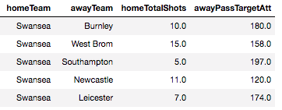
Model Exploration
Moving average calculations
A model for each season?
Notes:
Feature Sets
-How to calculate averages?
-Rolling, Expanding, Exponential

Slide 6

Model Exploration
Moving average calculations
A model for each season?
Season 10/11 to 15/16
Season 16/17
Season 17/18
Train
Test
Validation
Notes:
Experimented within season modeling, train/test split 70/30 – ended with 250 observations to train on
-Random Forests performed the best consistently

Slide 7
Where are the draws?
Notes:
Features are for a home or away team, most of the features aren’t related to a draw.
Draws are never going to be the most likely outcome.
people betting on the match do not want to see a boring result.
the idea of betting on dull match counter to the reason they bet in the first place, which is to be entertained.
Penalize the model for not classifying draws

Slide 8
Class Weights

Slide 9
Model Selection
Notes:
REASON FOR MICRO AVERAGE:
https://datascience.stackexchange.com/questions/15989/micro-average-vs-macro-average-performance-in-a-multiclass-classification-settin/16001#16001
Going forward I just picked

Slide 10
Feature Importance

Slide 11
Evaluating Predictions (Test)
Model Accuracy: 60%
Baseline Accuracy: 52%
Notes:
60% accuracy
52% home wins baseline

Slide 12
Evaluating Predictions (Validation)
Model Accuracy: 54%
Baseline Accuracy: 44%
Notes:
54% accuracy
44% home wins

Slide 13
Evaluating Predictions (Validation)
Model Accuracy: 54%
Baseline Accuracy: 44%
538 Accuracy: 51%

Slide 14
Next Steps
Recurrent Neural Networks
02
Different Betting Strategies
03
More Feature Engineering
04
Custom Scoring Functions
01

Slide 15
Questions?

Slide 16
Technical Appendix

Slide 17
Model Accuracy Score
Model | Accuracy Score
Logistic | 0.55
KNN | 0.49
Random Forest | 0.61

Slide 18
Tree from the Random Forest

Slide 19
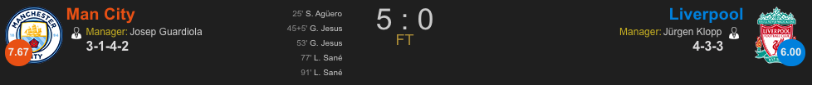
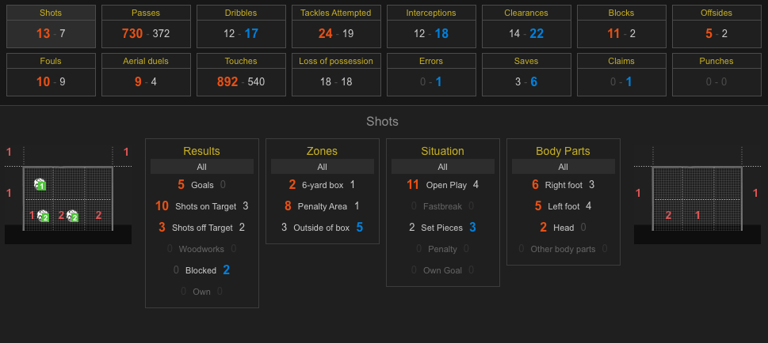
Sample Data

Slide 20
Within Season Modeling (2015-2016)

Slide 21
Within Season Modeling (2016-2017)

